Slide 1

Trade Barriers & Agreements

Slide 2
Trade Barrier:
Any means of preventing a foreign product or service from freely entering a nations territory.
Arguments:
Supporters: | Critics:
Believe that trade barriers save jobs, protect infant industries, and is in the best interest of national security. | Believe that free trade promotes better international relations, increases living standards, and is the best way to pursue comparative advantage.

Slide 3
Types of Trade Barriers:
Tariff: A tax on imported goods.
Import Quota: A set limit on the amount of a good that can be imported.
Sanctions: Actions a nation (or group of nations) takes in order to put pressure on another nation.
Embargo: A ban on trade with another country.
Notes:
In the movie “War Dogs” (Ppt image) the main characters make their money from selling military goods to the U.S. Government that was bought from China. The duo was able to buy the goods for pennies on the dollar because of the trade embargo between the U.S. and China during the time, and eventually arrested for trading with a country in which they were prohibited to do so.

Slide 4
Effects of Trade Barriers:
Higher prices for foreign goods:
  An increased price on foreign goods helps domestic producers compete with foreign firms, but consumers will be forced to pay higher prices.
Trade War: If one country decides to impose a trade barrier on a trading partner, they may retaliate by imposing restrictions of their own. If the first country responds with further trade limits, the result is a trade war.

Slide 5
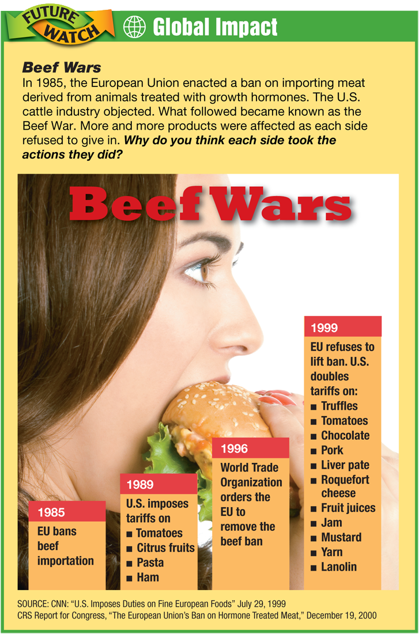
Who do you think was impacted by this trade war?

Slide 6
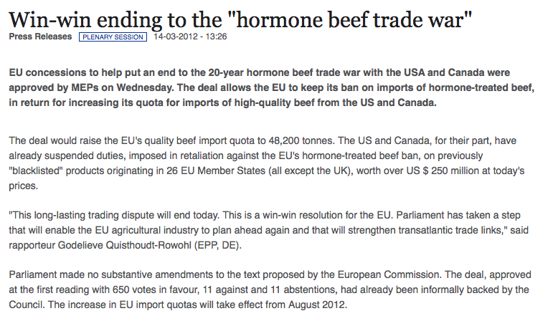
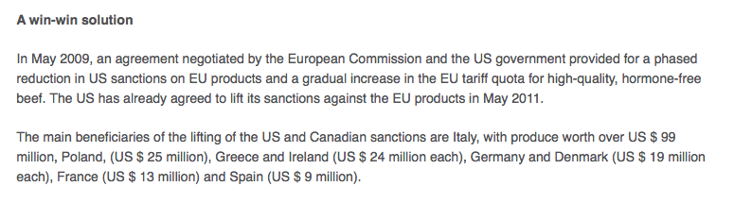
UPDATE!

Slide 7
Why impose a Trade Barrier?
Protectionism: The use of trade barriers to shield domestic industries from foreign competition.
Three main arguments for protectionism:
    Protecting jobs that may be hurt by foreign competition.
    Protecting Infant Industries that need time and experience to grow into larger producers.
    Safeguard National Security by making sure industries such as steel, energy, and advanced technology remain active in case of war or emergency.

Slide 8
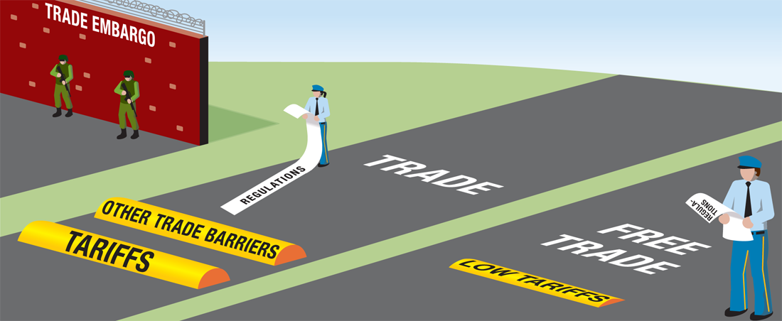
Free Trade
The opposite of protectionism is Free Trade where trade barriers between two or more nations are either lowered or eliminated all together.

Slide 9
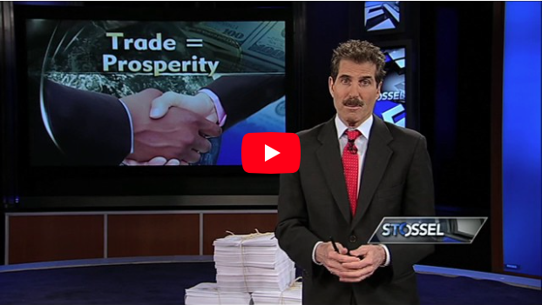
Stossel on Free Trade

Slide 10
World Trade Agreements:
To encourage free trade, countries participate in International Free Trade Agreements.
World Trade Organization (WTO): Founded in 1995, the WTO makes global trade more free and works as a referee to resolve issues and enforce rules agreed upon by member countries.

Slide 11
Regional Trade Agreements:
European Union (EU): An agreement between 27 European Nations that abolishes tariffs and trade restrictions among member nations.
North American Free Trade Agreement (NAFTA): A free trade zone linking the United States, Canada, and Mexico.
CAFTA-DR: Free trade agreement between the U.S. and Central American nations.

Slide 12
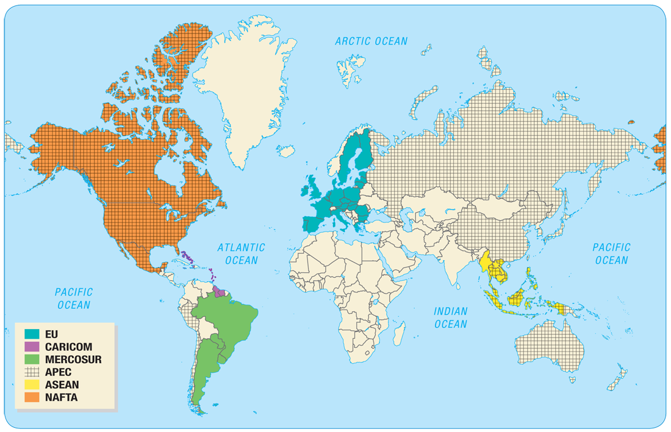
Notes:
APEC- Asia-Pacific Economic Cooperation
MERCOSUR- Southern Common Market: Brazil, Paraguay, Uruguay, Argentina, and Venezuela.
CARICOM- Caribbean Community and Common Market
ASEAN- Association of Southeast Asian Nations.

Slide 13
Multinationals
A large corporation that sells goods and services throughout the world is a multinational.
A multinational is beneficial to both corporation and host nation because:
  The corporation avoids certain fees and tariffs
  The corporation may benefit from cheaper labor.
  The host nation gains more jobs and tax revenue.
However host nations can become concerned that multinational corporations gain too much political power, drive out domestic industry, and exploit its workers.

